Slide 1
Medicaid and 340B
Addressing Health Equity and Access to Care
Jeff Davis
Of Counsel/Senior Advisor
Baker Donelson

Slide 2
Medicaid and the Safety Net
Medicaid is the backbone of America’s health care safety net
Safety net providers treat high volumes of uninsured, Medicaid, and other vulnerable patients
Medicaid expansion under the ACA expanded the role of Medicaid in the safety net

Slide 3
Medicaid and 340B
1965
Medicaid
1990
Medicaid Drug Rebate Program
1992
340B Drug Pricing Program

Slide 4
History of 340B Program
1992
Congress enacted 340B into law, signed by President Bush
2005
Congress adds children’s hospitals to 340B
2010
Congress expands 340B to include rural hospitals and free-standing cancer hospitals

Slide 5
340B Background
340B requires drug manufacturers participating in Medicaid and Medicare Part B to sell outpatient drugs at discounted prices to 340B providers
340B provides financial resources to providers treating high volumes of uninsured, Medicaid, and underinsured people
Providers use 340B savings to provide clinical and pharmacy services and support access to care

Slide 6
340B Providers
Clinics and Health Centers
Federally Qualified Health Center
FQHC Look-Alike
Ryan White HIV/AIDS Grantee
STD Clinic
Title X Family Planning Clinic
Hemophilia Treatment Center
Tuberculosis Clinic
Black Lung Clinic
Native Hawaiian Health Center
Tribal/Urban Indian Health Center
Hospitals
Disproportionate Share (DSH)
Free-Standing Children’s
Free-Standing Cancer
Critical access
Rural Referral Center
Sole Community Hospital
Must be public, non-profit, or granted governmental powers and must treat high-volume low-income patients or be rural

Slide 7
340B Hospitals
340B hospitals treat significantly more low-income people
Low-income people make up 42% of 340B DSH hospitals’ patient load versus 27% for non-340B hospitals
340B hospitals provide more uncompensated and unreimbursed care
340B DSH Hospitals represent only 38% of acute care hospitals, yet are responsible for 60% of the nation’s uncompensated and unreimbursed care—more than $26 billion a year

Slide 8
340B Savings
340B hospitals report using program savings to…
Provide uncompensated care and offset low reimbursement from Medicaid
Provide clinical, pharmacy, and auxiliary services (transportation, translation, social services)
Provide free or discounted drugs
Rural hospitals
Keep the doors open

Slide 9
340B and Mental Health
340B Hospitals Are…
64% more likely than non-340B hospitals to provide psychiatric emergency services
59% more likely to offer psychiatric geriatric services
More than 2.5 times more likely to provide psychiatric child and adolescent services

Slide 10
340B Challenges
More than 20 bills in last Congress, many of which would have restricted 340B
Interest in 340B transparency continues
Administration has floated possible changes that would restrict 340B

Slide 11
Contact Information
Jeff Davis
Of Counsel/Senior Advisor
Baker Donelson
jeffdavis@bakerdonelson.com
202-508-3414

Slide 12
Medicaid and 340B
Addressing Health Equity and Access to Care
Courtney Lang, JD - Langco + Partners

Slide 13
Why Health Equity and Why 340B?
Health Equity Defined:
Everyone has the opportunity to attain their highest level of health (APHA)
According to Healthy People 2020, we are tasked to achieve health equity, eliminate disparities, and improve the health of all groups.
Health equity means that everyone has a fair and just opportunity to be healthy (RWJF)
Together our understanding of health equity makes 340B even more important
We seek policy and advocacy solutions that bridge the divide for communities with the greatest need
The 340B drug pricing program is rooted in serving low income patients, those in the greatest need and is a fundamental program to protecting the U.S. health care safety net.

Slide 14
340B: Meeting Community Mental Health Needs
Access to care
Safety-net hospitals are more often embedded in the communities they serve, making accessing care easy and readily available to patients
340B works toward eliminating access challenges by offering service lines such as acute and longer-term psychiatric beds
Addressing transportation constraints
340B savings allows hospitals to provide services such as transportation support, outpatient behavioral programming and increasing psychiatric health provider, such as nurse practitioners on staff
Delivering emergency psychiatric care and support
340B hospitals are more likely than non-340B hospitals to provide emergency psychiatric services.
Safety-net hospitals are using their program savings to address diverse needs and offer care tailored to specific patient populations

Slide 15
Social Determinants of Health
Notes:
DeSalvo, Karen B. (2015). Healthy People 2020 Progress Review: Social Determinants of Health and Lesbian, Gay, Bisexual, and Transgender Health [PowerPoint Slides]. Retrieved from https://www.cdc.gov/nchs/ppt/hp2020/hp2020_lgbt_sdoh_progress_review_presentation.pptx.

Slide 16
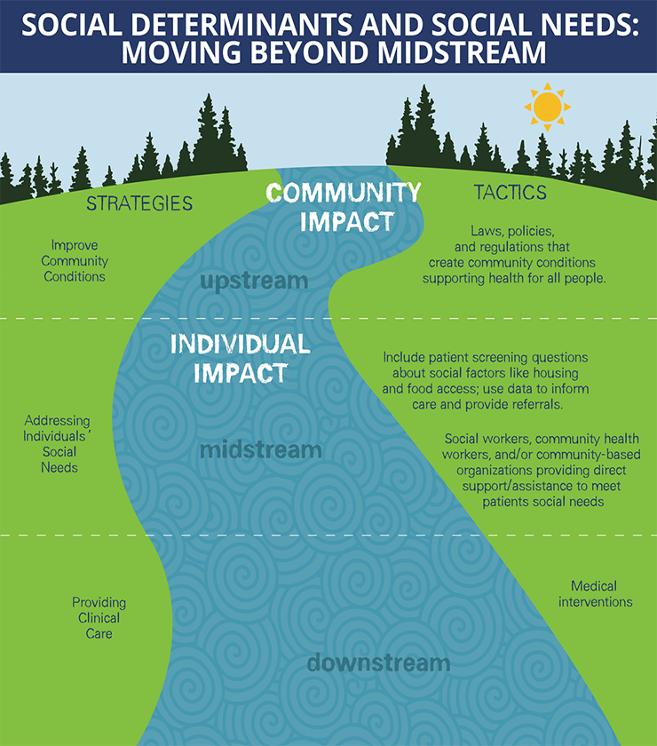
SDOH and 340B Advocacy
Advocacy, coalition building, etc.
Mold abatement, Uber / Lyft, etc.
Charity care, Medicaid, etc.
“Meeting Individual Social Needs Falls Short Of Addressing Social Determinants Of Health, " Health Affairs Blog, January 16, 2019. DOI: 10.1377/hblog20190115.234942

Slide 17
Mental Health Advocacy and Addressing Complex Chronic Disease
Leveraging peer support
Providing community education to reduce stigma
Understanding comorbidities and the complex nature of disease presentation
Augmenting outpatient care
Leading Outpatient Behavioral Health Integration Models
Some hospitals and health systems are developing formal behavioral health integration models for their PCPs.
Three typical models from the most integrated to least integrated.
Notes:
Fisher, Edwin B., et. al Global Evidence for Peer Support: Humanizing Health Care.

Slide 18
Whole Person
Asthma/ Pulmonary
Cancer
Infectious Disease
Heart Disease/ Hypertension
Mental Health
Whole Person
Prevention & Treatment
Resilience & Recovery
Addiction
Liver
Diabetes
Renal
Oral Health

Slide 19
340B Always Matters to Patient Care
Safety-Net Hospitals
340B hospitals are on the frontlines of treating underserved communities and people suffering from undertreated, chronic, and life threatening diseases and conditions.
Access to Care
340B helps hospitals serve low-income and rural patients.
Rural Communities
Geography matters – 340B institutions must show they treat large numbers of low-income patients or serve people in rural communities to qualify for the program.
The savings from drugs purchased at discounted prices are used for patient care – any changes to the 340B program could eliminate access to treatment and services.
Any cuts to 340B could result in diminished services provided to these patients.
340B restrictions could harm access to care for patients whose health care needs are delivered in rural communities.
Notes:
Ultimately, 30B is about access to care for low-income and rural patients
Hospitals can qualify for 340B only if they serve a high number of low-income patients or are located in a rural community
So any cuts to 340B would harm access to care for low-income and rural patients
The safety-net hospitals that qualify for 340B on the basis of their low-income patient loads are on the frontlines of treating underserved communities and patients suffering from undertreated, chronic, and life threatening diseases and conditions
These hospitals are providing high levels of uncompensated care and provide specialized services that are critical to these types of patients
[Include examples here of specific services tailored to the audience]
340B is also critical to rural hospitals located in remote areas
We frequently hear from rural hospitals that without 340B, patients would have to travel significant distances to access care

Slide 20
Saving Rural Hospitals
113 rural hospitals closed since 2010
More than 1,000 rural hospitals in 340B
Many are very small and the only hospital in their community
93% report using 340B savings to keep their doors open

Slide 21
#Protect340B
Partner with local 340B hospitals
Focus advocacy on equity for ALL patients to have access to quality mental health care (regardless of socio-economic status or geography)
Oppose efforts in Congress and states to limit the scope of 340B
Ask to MHA networks is to Make a WISE Choice and Support 340B!
Write an op-ed expressing concern against harmful proposed legislation
Issue a statement or newsletter post on how the legislation could harm patients
Send a letter to the Hill expressing concerns about the potential negative impact on patient care
Educate if not willing to be active
e.g. educating divergent viewpoints helps shift to or stabilize a neutral position
Goal: Minimize negative response to the 340B program; engage in dialogue that produces balance to stakeholder outreach; and encourage support for protecting the 340B program

Slide 22
Resources
https://www.340bhealth.org/

Slide 23
340B in Action: Southern Ohio Medical Center (Portsmouth, Ohio)
The 340B prescription drug program is a vital lifeline for safety-net providers, supporting critical health services in our communities. The program is narrowly tailored to reach only hospitals that provide a high level of services to low-income individuals or that serve isolated rural communities. Savings from the 340B program help hospitals meet the healthcare needs of vulnerable patients across the country. Congress should preserve and protect the 340B program as an essential part of the safety-net that does not rely on taxpayer dollars.
About us:
Southern Ohio Medical Center (SOMC) is a 240-bed medical surgical hospital in Southern Ohio that provides treatment to all patients, regardless of their ability to pay. Without 340B, many services would be scaled back and patients would have to drive long distances to receive the same level of care that SOMC provides.
We use our 340B savings to:
Expand medical care to remote service areas, including West Union and Waverly, Ohio, and Vanceburg, Kentucky.
Support a Patient Prescription Assistance Plan that fills prescriptions at our 340B cost. This benefits uninsured patients, or those unable to afford costly medications.
Embed a pharmacist in our Cancer Center, Infectious Disease Department, and Pulmonary Critical Care Department to provide consultation for complex medication therapies and improve patient outcomes.
Deliver medication along with education to the patient’s bedside upon discharge. Our goal is to improve medication adherence.
Offer medication take-home-packs to patients leaving the Emergency Room, so that they have enough medicine through the evening until retail pharmacies open the next day.
Maintain current services so uninsured patients do not have to travel far for care as we are the only inpatient facility in our area.
340B by the Numbers
$9M | Our annual approximate 340B savings
2,682 | Employees
76.4% | Percent of our patients on Medicaid, Medicare, or uninsured
$36M | Amount of uncompensated care we provide per year
$446K | Direct savings to patients for discounted drugs last year
90 | Number of 340B hospitals in Ohio

Slide 24
Contact Information
Courtney Lang, JD
Langco + Partners
advocacy@langcopartners.com

