Slide 1
MHA Annual Meeting Affiliates Post-Session, September 12, 2014
Paul Gionfriddo, President and CEO

Slide 2
Session Outline
Financial and Programmatic Overview
The MHA Business Plan
National Outreach
Building MHA and Affiliate Relationships in the Future

Slide 3
Financial and Programmatic Overview
MHA

Slide 4
MHA’s Financial Picture
2014 Budget: $3.7 M
Projected Profit/Loss: $11,000
Prior Year Profit/Loss: ($1.3 M)
YTD Rev/Exp: $2.3 M (Rev), $2.2 M (Exp)
Prior YTD: $1.6 M (Rev), $2.3 M (Exp)
Reserve Fund Balance: $1.4 M ($1.3 million 12/13)

Slide 5
Mental Health America’s MH Cycle
Prevention
Integrated Care and Treatment
Recovery
Early Identification and Intervention

Slide 6
Stages of Serious Mental Illnesses (SMIs) #B4Stage4
Stage 2
Mild cognitive impairment; first overt signs of mild to moderate symptoms.
Stage 3
Symptoms are severe, persistent, negatively impact overall health.
Stage 4
“Imminent Danger to Self or Others.”
Stage 1: Pre-symptomatic

Slide 7
MHA Division of Work
Mental Health/ Wellness
Prevention
Recovery
Public Education
Media
Funders
Policy
RPC
Agenda
Advocacy/
Engagement
Affiliates
Annual Meeting(s)
Early ID
Integrated Care
Public
Special Populations
Partners
Consumer
Policy Statements
Reports

Slide 8
MHA Business Plan
Process and Outcome

Slide 9
MHA’s Business Planning Process, 2014
Strategic Planning Retreat, 1/14
Board Approval of Process and Selection of BP Committee, 1/14
Affiliate Survey, 2/14
BP Draft for Board and staff review, 3/14
Board BP retreat, 3/14
Final BP circulated for Board approval, 4/14
BP implementation, 5/1/14
Final document incorporates BP sections, plus communications, marketing, and development plans, among other appendices.
40+ people, representing Board members, staff, and affiliates reviewed and commented on BP sections, and chose areas for priority work.

Slide 10
Criteria for Choosing Areas of Focus
Critical to MHA’s Mission.
Critical to MHA’s Survival.
Enhance MHA’s Brand.
Enhance MHA’s Presence and Impact.
Enhance MHA’s Financial Outlook.

Slide 11
10 Areas of Focus, 2014-2016
Board Development
Partner Outreach
Corporate Outreach
Database Management & IT
Communications (Internal)
Prevention and Children
Early ID and Intervention
Health and Behavioral Health Integration (w. peer supports)
Policy Advocacy: Affiliates, Partners, and the RPC
Communications (External)

Slide 12
Outreach
Internal and External

Slide 13
Partner Outreach
Kennedy Forum.
Depression and Bipolar Support Alliance.
NCBH.
National Association of Private Psych Hospitals.
Federation of Families for Children’s Mental Health.
Coalition to Stop Gun Violence.
Bazelon Center.
American Red Cross.
National Council on Aging.
Association of Child Psychiatry.
American Psychiatric Association.
PhrMA.

Slide 14
Congressional/Governmental Outreach
Joe Courtney (CT)
Lois Frankel (FL)
Ron Barber (AZ)
John Larson (CT)
Frank Pallone (NJ)
Tim Murphy (PA)
Sen. Patty Murray staff
Murphy Staff
Pallone Staff
E&C Staff
White House staff and advisors

Slide 15
Media Outreach
Goal: To place MHA’s mission and message (of Before Stage 4 Prevention, Early ID/Intervention, Integrated Care, and Recovery) in the media.
Regular FB and Twitter posts throughout the month, blogs, etc.
Hour background interview with 60 Minutes producer, May
Interviewed on CNN “New Day” with Chris Cuomo, May
BioCentury TV (WUSA, PBS), August
Guest blog, Health Affairs, August
US News and World Report, September
Losing Tim, September and beyond

Slide 16
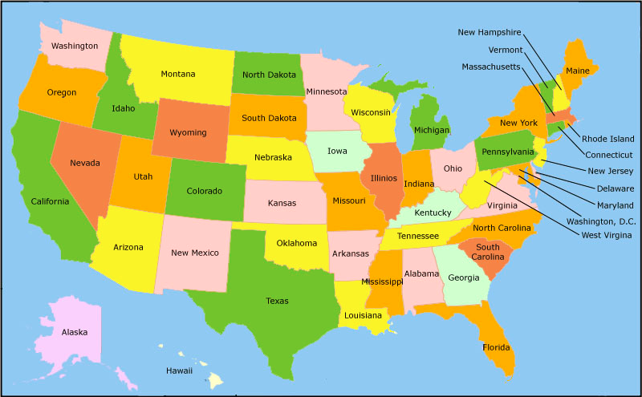
Affiliate Outreach

Slide 17
MHA’s Partnership with Affiliates
Two-Way

Slide 18
What Affiliates Want from MHA Affiliate Survey Responses, 2/14

Slide 19
What Affiliates Want from MHA
Signature programs*
ID best practices and innovations*
National marketing/branding/PR*
Networking with and for affiliates*
Use local affiliates to develop policy positions
Standardization of peer certification
Responses to open-ended questions (*most frequent), Affiliate survey, 2/14

Slide 20
MHA Draws Strength from Affiliate Innovations
Growing Grounds Farm (vocational program)
Suicide Prevention Trainings (school-based)
Homeless Veterans Stand Down (services to homeless veterans)
Our Child Our Divorce (parent education program)
Be Merge (health and behavioral healthcare integration training and TA)
Breaking Down Barriers (outreach and education to communities of color)
Bridging the Gap (emergency support and assistance for those in transition)
MHA Village (a fully integrated housing, employment, services area)
Advocates in State Juvenile Justice Facilities
Pro Bono Counseling/Project Access (volunteer services to uninsured people)
Intensive InCommunity Therapy for Youth
Stop Bullying Now!
RESPECT Institute (a 3.5 day program for people in recovery)
YES-Club Afterschool Program (for 11-18 year olds)
Hospital Crisis Diversion Services
Holiday Project Cheer (financial support and donations for consumers)

Slide 21
MHA Direct Revenue Sharing with Affiliates

Slide 22
MHA Indirect Revenue Sharing with Affiliates: For What else do Dues/Fees Help Pay?
Affiliate Relations Director.
Parts of two state/federal policy staff people.
Board and committee support.
CEO/staff visits.
Publications/newsletters/communications.
National branding/marketing.
Annual meeting costs (no profit from affiliate registration at annual meeting).

Slide 23
Collaborative Business Opportunities
MHA and MHA Affiliates

Slide 24
Screening
Affiliates can use MHA screening results to support follow-up activities.
MHA already sends people from screening results page to affiliates.
Can do state or zip code breakdowns (for local screening programs).
31 percent want additional info about where to go to get help.
18 percent want an easy way to find providers in the area.
14 percent want a way to contact a peer to discuss results and next steps.

Slide 25
State of the Nation’s Mental Health
Affiliates can seek funding to do special state and county data, evaluation, planning, and policy projects keyed to it.
MHA is using annually updatable data.
Moves dialogues to a broader focus.
Can evaluate local projects against these indicators.
People really like rankings.
KidsCount is the model.
Look at the Virginia mock-up for ideas.

Slide 26
Peer Credentialing
MHA exploring providing a national credential/certification for peer workers.
2014: West and east coast pilots (Kaiser Permanente and HCA).
MHA would credential for a fee.
MHA would franchise training to affiliates, who could then also charge a fee.
Workforce development opportunity.
Addresses cross-state challenges of local credentialing programs.

Slide 27
Regional Policy Council
The RPC will be the MHA/affiliate framework for informing policy efforts at the state (and national) level.
Up to eight $10,000 grants in 2015 to help with policy agenda development, coordination of 4 RPC meetings, and policy outreach to and coordination with other affiliates.
All affiliates will continue to be invited to RPC meetings to help develop policy agenda.
RPC to be expanded in 2015 to non-affiliate partners (who will have to pay to participate) and state policymakers.

Slide 28
Innovation Nation
MHA intends to help affiliates brand and distribute innovative programs as business opportunities for affiliates.
Innovation Nation will be featured at all MHA annual meetings.
Programs nominated will be collected in a program directory, and made available to other affiliates via the affiliate portal.
Can use these nationally-recognized programs for outreach to funders and possible replication.

Slide 29
Partnerships: MHA/American Red Cross
MHA will make available to affiliates special co-branding opportunities with local chapters/affiliates of other national partners.
MHA and ARC letter of agreement to create umbrella under which local affiliates can provide MH services post-disaster.
Offers a new local branded partnership opportunity.
Program is voluntary.
24/7 back-up through the National Disaster Distress Helpline (SAMHSA funded, MHA-NYC Link2Health program).
Free Psychological First Aid (PTSD) training, too.

Slide 30
Special Opportunities: Mental Health First Aid Training
MHA offers affiliates limited-time opportunities to improve affiliate skills and training.
2014 opportunity only for MH First Aid Train the Trainer training.
MHA Maryland will train affiliates who wish to have a trainer on staff.
Training November 17-21, in Maryland
MHA will cover all the cost of the training, plus 2 meals a day, plus $750 toward travel/lodging expenses.
Limited to 25 affiliate representatives.

Slide 31
MHA: 10 Benefits of Affiliation
MHA Marketing/Branding Opportunities
Broad-based focus on mental health
Annual Policy Agenda/Regional Policy Council meetings
National Advocacy and Messaging
Access to more than 200 other state and local organizations with similar goals
Annual Meeting (Discounted), with expert presenters and partners from around the nation
Screening and MH Status of the Nation exposure and follow-up options
Innovation Nation Programming options
Business Partnerships, including exclusive access to certain products (e.g., MH First Aid training in 2014)
Joint fundraising opportunities (e.g., Navigator, 2013)

Slide 32
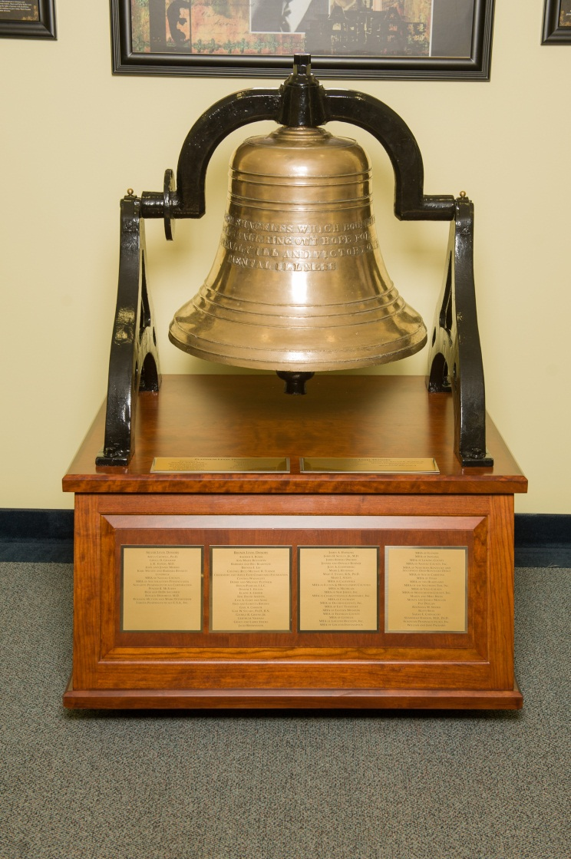
MENTAL HEALTH AMERICA
We stand for:
Prevention for all;
Early identification and intervention for those at risk;
Integrated health and behavioral health care for those who need it; and
Recovery as a goal.

Slide 33
THANK YOU, QUESTIONS, and DISCUSSION.

