Slide 1
Childhood Mental Health: Early intervention as Prevention
William Copeland, PhD
Center for Developmental Epidemiology
Duke University Medical Center
Mental Health American
Atlanta, GA
Sept 11th 2014
Notes:
Change the font to Arial and bold.
Add risk factor/cumulative prevalence.

Slide 2
No conflicts of interest or financial disclosures Grant support from NIMH, NIDA, NARSAD, and W.T. Grant

Slide 3
The best plan to reduce the burden of mental illness is to reduce the number of childhood cases

Slide 4
Early Intervention is Prevention
Childhood MH problems can be easily identified
Substantial number of childhood cases
Childhood MH problems predict adult MH problems
Adult MH issue often start in childhood
Setting in which children can be screened
Treatments are efficacious/effective

Slide 5
Notes:
5

Slide 6
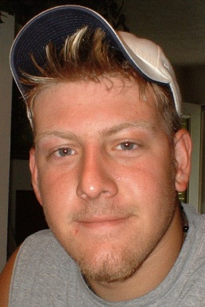
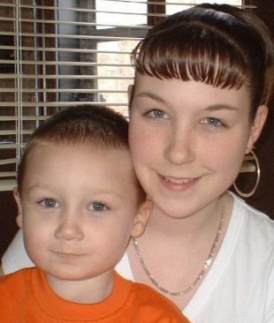
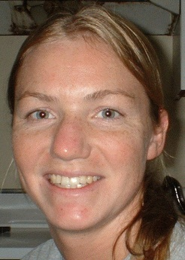
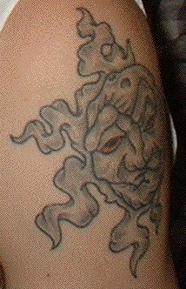
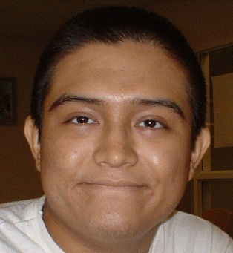
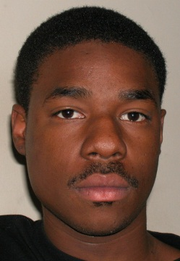
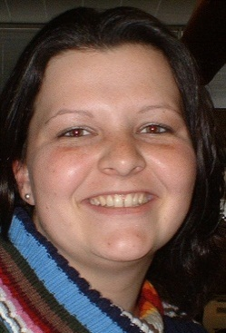
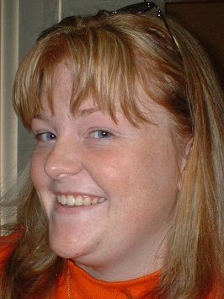
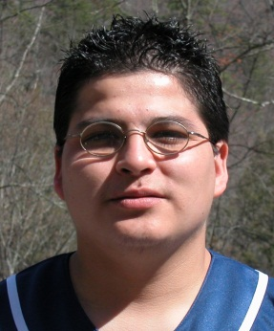
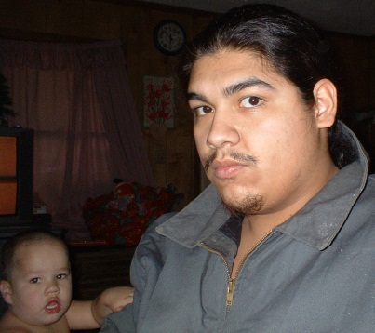
GSMS

Slide 7
Great Smoky Mountain Study

Slide 8
How common is MI? 3 month Prevalence
Another 16% have a impairment but not a disorders
Of those with a disorder, about half also have a functional impairment (SED)

Slide 9
How common are psychiatric disorders? Cumulative Burden

Slide 10
Global Burden of Disease 2010
Gore, FM., Bloem, PJN, Patton, GC, Ferguson, J, Joseph, V, Coffey, C, Sawyer, SM, & Mathers, CD (2011). Global burden of disease in young people aged 10–24 years: a systematic analysis. Lancet, DOI:10.1016/S0140-6736(11)60512-6

Slide 11
How often does mental illness early?

Slide 12
Risk for adult disorders

Slide 13
Continuity from childhood:
 | Adult status
Childhood dx | Any dx | No Sub.
No dx or impair. | 20.8 | 11.3
Impairment only | 29.9 | 22.8
Any disorder | 59.1 | 40.5
Anxiety | 60.6 | 44.2
Depression | 67.1 | 52.3
DBD | 55.8 | 39.9
Substance | 71.4 | 37.6
Notes:
Reviewing the literature on early-maturing girls in 1990, Stattin and Magnusson (5) noted a “scarcity of systematic studies addressing the issue of long-range impact” (p. 301).

Slide 14
Key Outcomes
Multiple mental health problems
Dropping out of high school
Death
Serious criminal activity
Unable to keep job
Early parenthood
Extended unemployment
No social support network

Slide 18
As compared to noncases, childhood cases were:
7 times as likely to report a key outcome
12 times as likely to report 2 outcomes
6 times as likely to have multiple MH issues
8 time as likely to have 2+ addictions
14 times as likely to be incarcerated
6 times as likely to drop out of high school
8 times as likely to lack all social support

Slide 19
Do they get help? Service Utilization Rates
Childhood
Young Adulthood
Notes:
Takeaway:
Drop in both raw and conditional service use rates into adulthood
In this group where the rates of disorder go up, the rates of service utilization go down substantially. The unmet need is significant.
Conditional rates drops from 50.5% to 24.5% from childhood to adulthood.

Slide 20
Conditional Service Utilization Rates
 | Childhood % | Young Adulthood %
Any* | 50.7 | 24.2
Specialty Psych* | 19.0 | 10.0
Gen. Med. | 10.4 | 7.2
Education/Job* | 23.7 | 0.3
Crim. Justice | 5.4 | 5.4
Informal* | 16.8 | 7.6
Notes:
Takeaway:
Drop in both raw and conditional service use rates into adulthood
The single most common setting that individuals receive services in childhood is the school setting and that drops almost completely in young adulthood
There is no corresponding increase elsewhere. Utilization of specialty mental health services, general medical, or informal services stays the same.
In this group where the rates of disorder go up, the rates of service utilization go down substantially. The unmet need is significant.
Conditional rates drops from 50.5% to 24.5% from childhood to adulthood.

Slide 21
Early Intervention is Prevention
Childhood MH problems can be easily identified
Childhood MH problems predict adult MH problems
Adult MH issues often start in childhood
Treatments are efficacious/effective
Early problems can be avoided

Slide 22
Childhood present a distinct
challenge for mental health public policy
Many children affected
High levels of unmet need
Care not always optimal
Story gets worse in young adulthood

Slide 23
It also presents an opportunity
Prevent adult MH problems
Improve the transition to adulthood for many
Change MH trajectories that can last for decades

Slide 24
Ideas
Early identification
Universal home visitation
Universal MH screening in schools
Reduce parental burden
Universal child care
Improve access
Integrated MH clinics

Slide 25
Mean Cumulative ED-Related costs

