Slide 1
Community Well-Being
William W Thompson, PhD
Senior Scientist
National Centers of Birth Defects & Developmental Disabilites
Centers for Disease Control & Prevention
“The findings and conclusions in this presentation are those of the author and do not necessarily represent the OFFICIAL POSITION of the Centers for Disease Control and Prevention.”

Slide 2
Centers for Disease Control and Prevention
www.cdc.gov 1-800-CDC-INFO
Notes:
Collaborating to create the expertise, information, and tools that people and communities need to protect their health – through health promotion, prevention of disease, injury and disability, and preparedness for new health threats.
CDC seeks to accomplish its mission by working with partners throughout the nation and the world to
monitor health,
detect and investigate health problems,
conduct research to enhance prevention,
develop and advocate sound public health policies,
implement prevention strategies,
promote healthy behaviors,
foster safe and healthful environments,
provide leadership and training.
Those functions are the backbone of CDC′s mission. Each of CDC′s component organizations undertakes these activities in conducting its specific programs. The steps needed to accomplish this mission are also based on scientific excellence, requiring well-trained public health practitioners and leaders dedicated to high standards of quality and ethical practice.

Slide 3
Overview of Today’s Talk
Describe CDC Mental Health Activities
Define Health-Related Quality of Life & Well-Being
Provide an overview of Healthy People 2020 Activities
Health-Related Quality of Life & Well-Being Workgroup
Mental Health Workgroup

Slide 4
Mental Health Activities at CDC
Notes:
Focus is on Surveillance, evaluation and prevention.

Slide 5
Mental Health Coordinator Tasks
Define public health vision of mental health at CDC
Define the role of mental health in advancing CDC’s mission
Develop recommendations for CDC leadership for future directions for a mental health function at CDC
Provide leadership in advancing CDC’s work in a coordinated approach to mental health

Slide 6
Mental Health Work Group
Mission Statement:
CDC-wide scientific work group fostering collaboration and advancement in the field of mental health in support of CDC's commitment to promote health, prevent disease and injury, and improve quality of life.
Members communicate informally between meetings, sharing ideas and information and collaborating on mental health related projects as part of their regular CDC assignments.

Slide 7
Mental Health Work Group Activities (cont.)
Biennial Mental Health
Surveillance Meeting
Task Forces
Communication
Preparedness
Surveillance
Public Inquiry
Global Mental Health
www.cdc.gov/mentalhealth/
Notes:
Working to update/improve mental health website so it will be a more comprehensive resource and link to all CDC mental health activities.

Slide 8
How does WHO define health?
The World Health Organization defines health as “a state of complete physical, mental and social well-being and not merely the absence of disease or infirmity.” ¹

Slide 9
Health-Related Quality of Life & Well-Being
HRQOL & WB are multi-dimensional concepts that include domains related to physical, mental, emotional, and social functioning.
HRQOL & WB outcomes are important because they tell us how people perceive their life is going from their own perspective.

Slide 10
How do we measure Well-Being?
Positive evaluations of people’s daily lives—when they feel very healthy and satisfied or content with life, the quality of their relationships, positive emotions, realization of potential
Presence of positive affect, absence of negative affect and life satisfaction
Tends to be asset-based rather than deficit-based

Slide 11
Satisfaction with Life Scale (SWLS) (Diener et al, 1985)
In most ways, my life is close to ideal.
The conditions of my life are excellent.
I am satisfied with my life.
So far, I have gotten the important things I want in life.

Slide 12
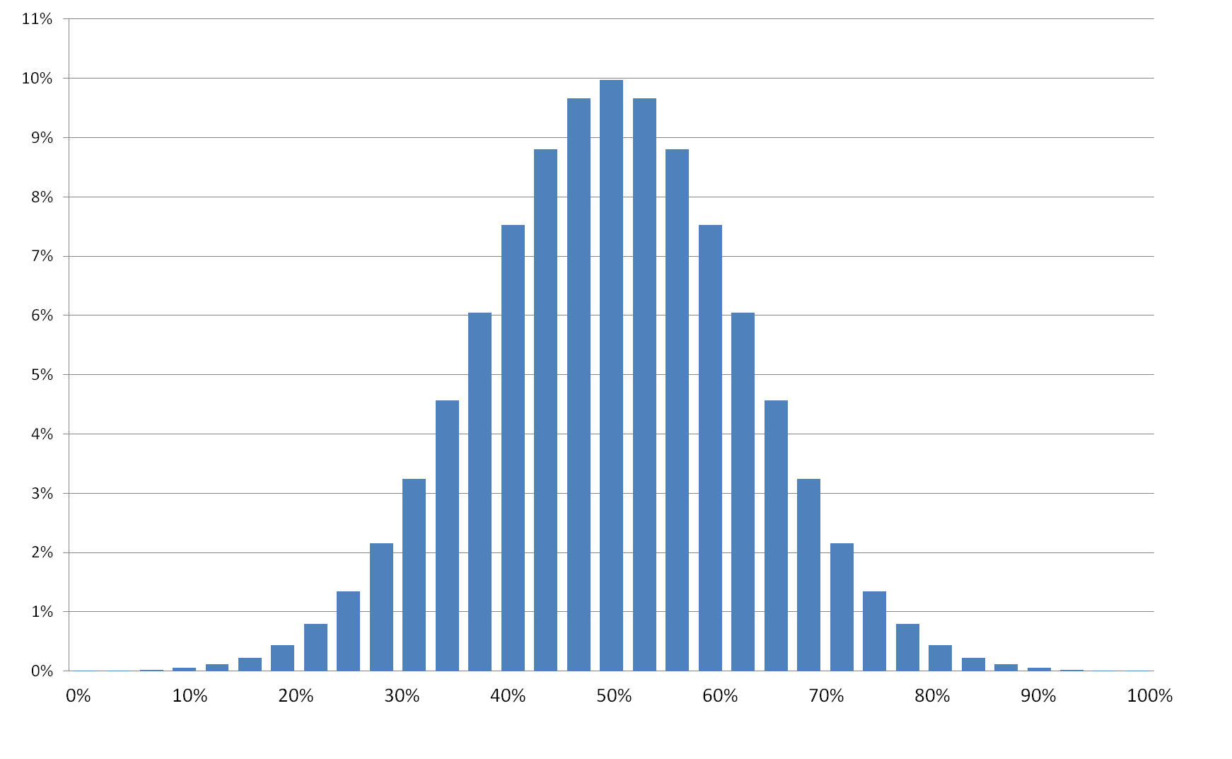
Theoretical Mental Health Continuum
30
40
50
60
70
Disease
No Disease
Poor
Mental
Health
Good
Mental
Health

Slide 13
Theoretical Well-Being Continuum
30
40
50
60
70
Dissatisfied
With Life
Satisfied
With Life

Slide 14
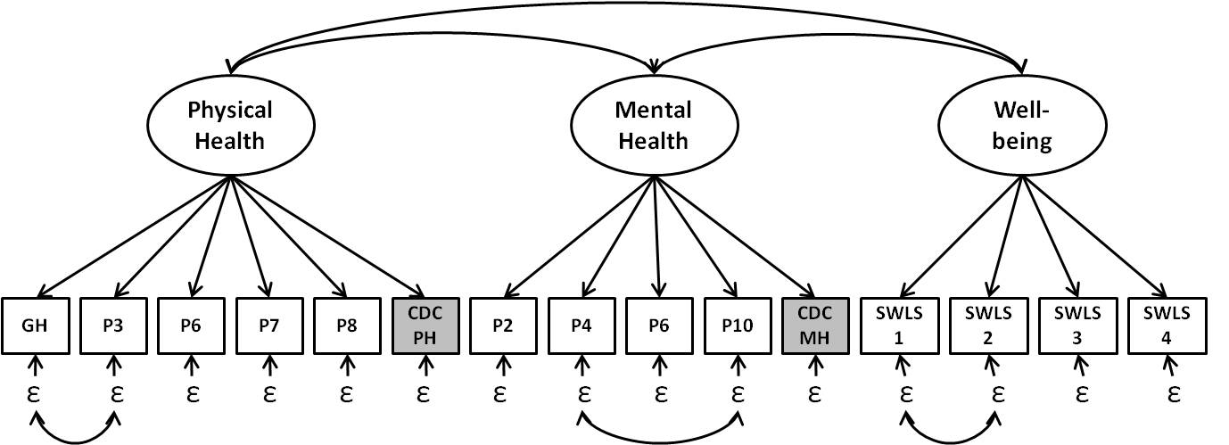
Measurement of HRQOL & WB

Slide 15
Measurement Study #2 SF-36 & CDC Healthy Days Items
Physical Function
CDC Physically Unhealthy Days
Physical Health
Role Physical
Bodily Pain
SF-36 Domains
Well-Being
Health
General Health
Vitality
Social Function
Mental Health
Role Emotional
Mental Health Role
CDC Mentally Unhealthy Days

Slide 16
CDC Well-Being Study (Kobau et al, 2010)

Slide 17
CDC Well-Being Study (Kobau et al, 2010)

Slide 18
Epidemiology of HRQOL & WB
Chronic Conditions
1. Heart Disease
2. Diabetes
SES – Individual Level Factors
1. Salary
2. Education
Health Behaviors
1. Smoking
2. Exercise
Social Support
1. Family & Friends
2. Marital Status
2. Community Level Factors
Stressful Life Events
1. Adverse Childhood Events
2. Physical / Sexual Assault
3. Combat Exposure
Social Determinants of Health
1. Neighborhood Factors
2. Unemployment Rates
3. Housing Occupancy

Slide 19
Policy Relevance of HRQOL & WB
Track national trends over time
Assess success of state and local health initiatives
Determine Unmet Needs – Health Disparities
Assess Healthy People 2020 Goals and Objectives

Slide 20
Healthy People 2020
Promoting Health and Preventing Disease Throughout the Nation
Notes:
20
20

Slide 21
Evolution of Healthy People
Target Year | 1990 | 2000 | 2010 | 2020
Overarching Goals | Decrease mortality: infants & adults Increase independence among older adults | Increase span of healthy life Reduce health disparities Achieve access to preventive services for all | Increase quality and years of healthy life Eliminate health disparities | Attain high-quality, longer lives free of preventable disease Achieve health equity; eliminate disparities Create social and physical environments that promote good health Promote quality of life, healthy development, healthy behaviors across life stages
# Topic Areas | 15 | 22 | 28 | 42*
# Objectives/ Measures | 226/NA | 312/NA | 467/1,000 | >580/1200
39* With objectives
Notes:
The number of objectives has increased with each decade. Healthy People 1990 set forth 226 objectives, Healthy People 2000 included 312 objectives, Healthy People 2010 identified 467 objectives with 1,000 measures, and Healthy People 2020 has nearly 600 objectives with 1,200 measures.

Slide 22
HRQOL & Well-Being Topic Area Relevant to Overarching 2020 Goals
Attain high-quality, longer lives free of preventable disease, disability, injury, and premature death.
Achieve health equity, eliminate disparities, and improve the health of all groups.
Create social and physical environments that promote good health for all.
Promote quality of life, healthy development, and healthy behaviors across all life stages.
22

Slide 23
HRQOL & Well-Being Workgroup
Workgroup started meetings in March 2009
WG defined 3 complementary measurement approaches:
Self-rated Physical and Mental Health (HRQOL)
Well-Being
Participation in Society
3 measurement approaches developed from literature review, public comments, and open discussions
Topic area approved by Federal Interagency Workgroup (FIW) Winter, 2010
23

Slide 24
3 Measurement Approaches
Self-rated physical and mental health (HRQOL)
Measures physical and mental health symptoms, including functioning and general health perceptions
Generally deficit-based
Well-Being
Generally measures the positive evaluations of people’s daily lives—when they feel very healthy and satisfied or content with life, the quality of their relationships, positive emotions, realization of potential
Presence of positive affect, absence of negative affect and life satisfaction
Generally asset-based
24

Slide 25
3 Measurement Approaches (con’t.)
Participation
Measures individuals’ perceptions of the impact of their health and functional status on their participation in society
Participation includes education, employment, civic, social and leisure activities.
Assumption: a person with a functional limitation (e.g., vision loss, mobility difficulty) can live a long and productive life and enjoy a good quality of life
25

Slide 26
HP2020 HRQOL 1st Objective Officially Approved!
Primary Objective: Increase proportion of adults who self-report good or better health.
Subobjective 1: Increase proportion of adults who self-report good or better physical health.
Subobjective 2: Increase the proportion of adults who self-report good or better mental health

Slide 27
PROMIS Mental Health Items NHIS 2010 Data (Adults 18+)
PROMIS Item | Response | Weighted Percent
1. In general, would you say your quality of life is: (Global02) | Fair / Poor | 8.3%
2. In general, how would you rate your mental health, including mood and ability to think? (Global04) | Fair / Poor | 7.8%
3. In general, how would you rate your satisfaction with social activities / relationships? (Global05) | Fair / Poor | 9.3%
4. How often have you been bothered by emotional problems? (Global10) | Often / Always | 6.4%
These four items are used to estimate the composite Mental Health T-Score

Slide 28
Option 1: Increase the Population Mean for HRQOL & WB *
30
40
50
60
70
* Operationalized Using Satisfaction With Life Scale (Diener et al, 1992)

Slide 29
Option 2: Increase the proportion of adults who report
“good enough” HRQOL & WB
30
40
50
60
70
1 STD ~ 10 units
* Operationalized Using Satisfaction With Life Scale (Diener et al, 1992)

Slide 30
Option 3: Increase the proportion of adults who report
“very good” or “excellent” HRQOL & WB
Poor
Fair
Good
Very
Good
Excellent
~32
~40
~47
~54
~61
* Operationalized Using Satisfaction With Life Scale (Diener et al, 1992)

Slide 31
Adults Who Report Good or Better Mental Health, 2010
HP2020
Target: 80.1
Increase desired
Age (years)
NOTES: Data (except data by age group) are age adjusted to the 2000 standard population.
SOURCE: National Health Interview Survey (NHIS), CDC/NCHS.
Obj. HRQOL/WB-1.2
31

Slide 32
Adults Who Report Good or Better Mental Health, 2010
HP2020
Target: 80.1
Increase desired
NOTES: Data are age adjusted to the 2000 standard population.
SOURCE: National Health Interview Survey (NHIS), CDC/NCHS.
Obj. HRQOL/WB-1.2
32

Slide 33
Well-Being Subcommittee Proposed Objectives
Increase proportion of adults who reported very high life satisfaction (better mental well-being) --- 38% of U.S. adults
Increase proportion of adults who reported they felt very healthy and full of energy on 20 or more days in the past 30 days (better physical well-being). ---- 69% of U.S. adults

Slide 34
HP2020 Mental Health Workgroup
34

Slide 35
Major Depressive Episode (MDE) among Adolescents, 2012
HP2020 Target: 7.5
Age
NOTE: Data are for adolescents aged 12-17 years who reported having a Major Depressive Episode (MDE) in the past 12 months. American Indian includes Alaska Native. Native Hawaiian includes other Pacific Islander. The categories black and white exclude persons of Hispanic origin. Persons of Hispanic origin may be any race.
SOURCE: National Survey on Drug Use and Health (NSDUH), SAMHSA.
Obj. MHMD-4.1
Decrease Desired
Notes:
Healthy People 2020 objective MHMD-4.1 tracks the proportion of adolescents aged 12 to 17 years who experience major depressive episode (MDE).
HP2020 Baseline: In 2008, 8.3 percent of adolescents aged 12 to 17 years reported having a major depressive episode in the past 12 months.
HP2020 Target: 7.5 percent, a 10 percent improvement over the baseline.
Disparities were observed for a number of population groups in 2011, for example:
A lower proportion of adolescent males reported having a MDE in the past 12 months, 4.5% compared to adolescent females, 12.1%. The rate for females was more than two and a half times that for males.
Black non-Hispanic adolescents reported having the lowest proportion of MDE in the past 12 months, 7.0%, compared to 8.6% for white non-Hispanic adolescents and 9.5% for American Indian or Alaska Native adolescents. The rates for white non-Hispanics and American Indian or Alaska Native adolescents were 23% and 36% higher than that for Black non-Hispanic adolescents, respectively, although the difference between black non-Hispanic and American Indian or Alaska Native adolescents was not statistically significant.
Among age groups, adolescents 12-13 years old reported having the lowest proportion of MDE in the past 12 months, 4.1%, compared to 8.6% among 14-15 year olds and 11.7% among 16-17 year olds. Rates for 14-15 year olds and 16-17 year olds were more than twice as high and nearly three times as high as the rate for 12-13 year olds, respectively.

Slide 36
Major Depressive Episode (MDE), Adults, 2012
Total
HP 2020 Target: 5.8
Female
Male
American Indian or Alaska Native
Asian
Two or more races
Black, non-Hispanic
White, non-Hispanic
Hispanic or Latino
Less than high school education
High school graduate
Some college
Four-year college degree
Advanced degree
NOTES: Data are for the proportion of adults aged 18 and over who experienced a Major Depressive Episode in the past 12 months. Respondents were asked to select one or more races. The single-race categories include persons who reported only one racial group. Persons of Hispanic origin may be of any race. Data by education are for persons aged 25 and over.
I = 95% confidence interval.
SOURCE: National Survey on Drug Use and Health (NSDUH), SAMHSA.
Obj. MHMD-4.2
Decrease Desired

Slide 37
Suicides by Age, 2010
Age
Obj. MHMD-1
Decrease Desired
NOTE: Data are for ICD-10 codes *U03, X60-X84, Y87.0 reported as underlying cause. Data for the total population are age adjusted to the 2000 standard population.
SOURCE: National Vital Statistics System-Mortality (NVSS-M), CDC/NCHS.
Notes:
Among age groups, 45-64 year olds had the highest suicide rate in 2010, 18.6 per 100,000 population. Rates for the other groups were:
3.8 for 12-17 year olds
12.6 for 18-24 year olds
15.0 for 25-44 year olds
14.9 for those 65 years and older

Slide 38
Suicide Attempts among Adolescents, 2011
HP2020 Target: 1.7
only rate (e.g per 100 persons) is not used with a percent?
(Per 100 Persons)
NOTE: Data are for students in grades 9 through 12 who reported making suicide attempts that required medical attention in the past 12 months. American Indian includes Alaska Native. Native Hawaiian includes other Pacific Islander. The categories black and white exclude persons of Hispanic origin. Persons of Hispanic origin may be any race.
SOURCE: Youth Risk Behavior Surveillance System (YRBSS), CDC/NCHHSTP.
Obj. MHMD-2
Decrease Desired
Notes:
Healthy People 2020 objective MHMD-2 tracks the proportion of adolescents in grades 9-12 who reported making suicide attempts that required medical attention.
HP2020 Baseline: In 2009, 1.9 percent of adolescents in grades 9-12 reported making suicide attempts that required medical attention in the past 12 months.
HP2020 Target: 1.7 percent, a 10 percent improvement over the baseline.
Disparities were observed for a number of population groups in 2011, for example:
Males had a lower proportion of adolescents who reported suicide attempts in the past 12 months, 1.9% compared to females, 2.9%. The rate for females was approximately one and a half times that for males.
White non-Hispanic adolescents reported having the lowest proportion of suicide attempts in the past 12 months, 1.9%, compared to 3.2% for Hispanic, 4.5% for Asian and 6.6% for American Indian or Alaska Native adolescents. The rates for Hispanic, Asian, and American Indian or Alaska Native adolescents were more than one and a half times, nearly two and a half times, and approximately three and a half times that for White non-Hispanic adolescents, respectively.

Slide 39
Percent of Adults Age 18 and Older With Serious Mental Illness Who Receive Treatment, 2012
HP2020
Target: 64.6
Obj. MHMD-9.1
Increase Desired
NOTE:
SOURCE: National Survey on Drug Use and Health (NSDUH), SAMHSA.

Slide 40
Percent of Adults Age 18 and Older With Major Depressive Episodes Who Receive Treatment, 2012
HP2020
Target: 64.6
Obj. MHMD-9.2
Increase Desired
NOTE:
SOURCE: National Survey on Drug Use and Health (NSDUH), SAMHSA.

Slide 41
Percent of Primary Care Physicians Who Screen Adults Aged 19 Years and Older for Depression During Office Visits, 2010
HP2020 Target: 2.4
Obj. MHMD-11.1
Increase Desired
NOTE:
SOURCE: National Ambulatory Medical Care Survey, NCHS, CDC.

Slide 42
Healthy People 2020 Webinar
Promoting and Measuring Well-Being and HRQOL:
A Healthy People 2020 Spotlight on Health Webinar
Register Now | September 25, 2014 | 12:30 to 2:00 p.m. ET
Notes:
42
42

Slide 43
Policy Relevance of HRQOL & WB
Track national trends over time
Assess success of state and local health initiatives
Determine Unmet Needs – Health Disparities
Assess Healthy People 2020 Goals and Objectives

Slide 44
Contact Information
William W. Thompson, PhD National Center for Birth Defects and Developmental Disabilities
U.S. Centers for Disease Control and Prevention
E-mail: wct2@cdc.gov
http://www.cdc.gov/ncbddd/child/default.htm

Slide 45
Atlanta Arts Festival No Komment (Blues Band) Sunday 12:00 Noon
Justin Madison Jessica Miles Max

