Slide 1
Mental Health America: mhascreening.org
Paul Gionfriddo
Theresa Nguyen

Slide 2
MHA Screening: What We Are Learning from Early Identification
Prevention
Integrated Care and Treatment
Recovery
Early Identification and Intervention

Slide 3
MHA Screening (mhascreening.org)
Launched 4/22/14 online.
Four screening tools – depression, anxiety, bipolar, PTSD.
Anonymous screening.
Immediate results.
Voluntary demographic data input.
Survey questions (customizable).
Follow-up options.
1,000 screens per day.

Slide 4
MHA Screening
Provides valuable insight into the mental health and well-being of America as a whole.
Identifies specific mental health concerns among segments (geographic, demographic) of the population.
Suggests approaches and strategies for reaching people who are concerned about their own mental health and well-being.

Slide 5
The First 100,000 Screens: Women v Men

Slide 6
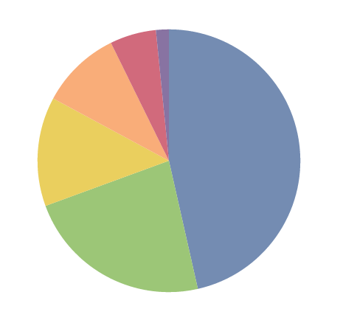
Age of Screeners
55-64
6%
65+
2%
45-54
10%
18-24
45%
35-44
13%
25-34
23%

Slide 7
Race/Ethnicity

Slide 8
30 States with 500+ Screens Completed
2500+: CA, TX, FL, NY
1500+: PA, OH, IL
1000+: MI, IN, NC, GA, NJ, VA, TN, WA
500+: AL, CO, CT, IA, KY, LA, MA, MD, MO, MN, OK, OR, SC, UT, WI

Slide 9
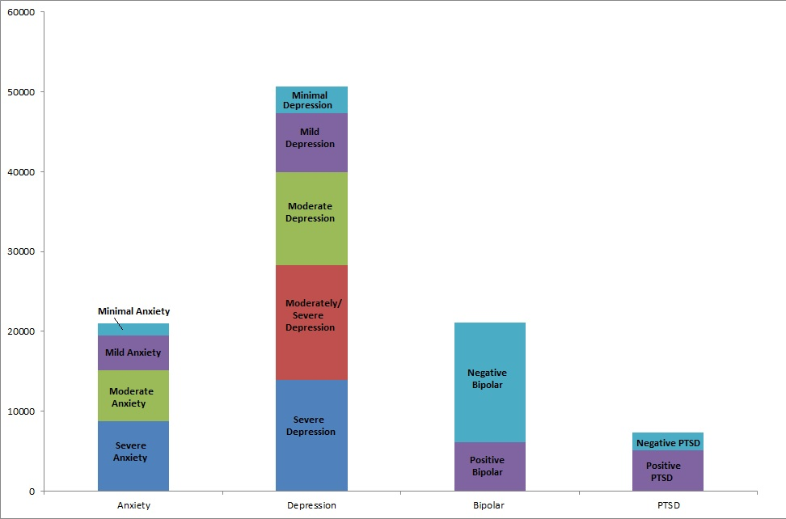
Overall Results: Moderate to Severe
39,927 People Scored Moderate to Severely Depressed
66,341
15,117 People Scored Moderate to Severely Anxious
6,184, People Scored Positive for Bipolar
5,113, People Scored Positive for PTSD

Slide 10
Are you currently, or have you ever been, diagnosed with a mental health condition by a professional?

Slide 11
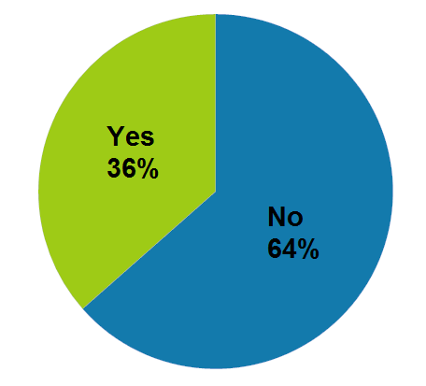
Diagnosed – Moderate to Severe
NOT Diagnosed:
23,965 People

Slide 12
Results: Low Income v. High Income

Slide 13
What Next Steps Do You Plan To Take?

Slide 14
What Might You Want From MHA?

Slide 15
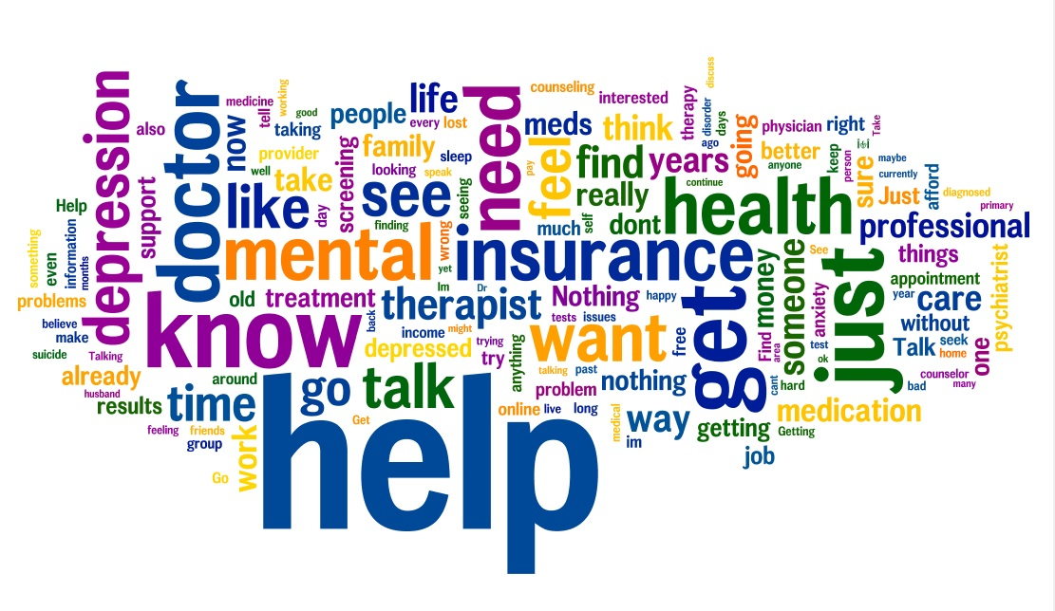

Slide 16
THANK YOU AND QUESTIONS.

