Slide 1
MHA: Looking Forward B4Stage4
2014 Annual Meeting Wrap-up
Paul Gionfriddo, President and CEO

Slide 2
B4Stage4

Slide 3
B4Stage4
In 2015…
Marketing and messaging.
Focus on prevention and earlier interventions.
Outreach to youth and special populations.
Tie-in to advocacy around other (often co-occurring) chronic conditions.
Our call to action.

Slide 4
B4Stage4 Marketing and Messaging
Program branding.
Social media.
Ubiquitous symbol.
Elevator speech (with time to spare!).

Slide 5
B4Stage4 Prevention and Earlier Intervention
Promotes wellness strategies.
Expanded MH screening.
Targeted referrals.
Supports comprehensive services – including health care, counseling, pharmacological, peer, family, and social supports.
Integration of health and behavioral health.

Slide 6
#B4Stage4 Outreach to Youth and Special Populations
Twitter hashtag/social media connection.
Logo design contest.
Core public education take-home.

Slide 7
B4Stage4 Tie-In to Chronic Disease Advocacy
Anti-stigmatizing, anti-discriminatory.
Builds a bridge to other advocates.
Creates a language for integrating disease management strategies.
Tie-in to advocacy around other (often co-occurring) chronic conditions.

Slide 8
B4Stage4 Our Call To Action
Defines our mission and unique space.
Erects a big tent.
Communicates what we want.
Invites endorsements/petition signing.

Slide 9
B4Stage4: MHA’s Reach
Email: 25,000
Screening (est.): 300,000 annually
Website: 2 million annually
Mental Health Month: 3,000 downloads,
3 million+ reach

Slide 10
MHA and NAMI: New Media Presence

Slide 11
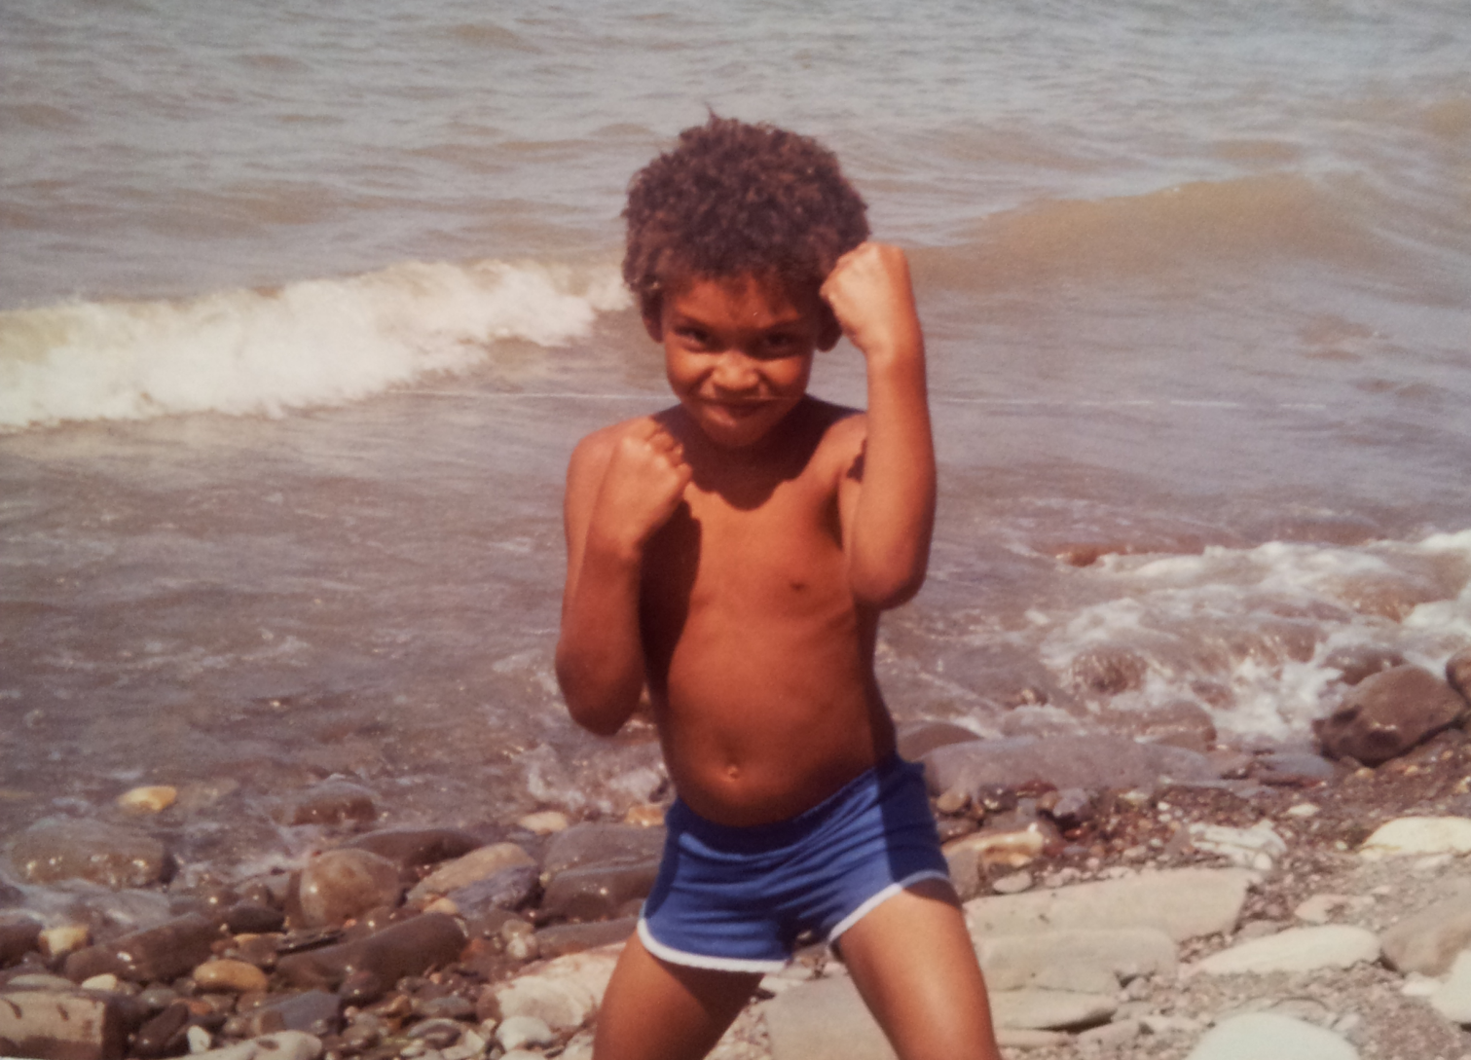
What Comes Before Stage 4
Wellness and Prevention
Early identification
Early intervention
Integrated care
Family support
Peer support
Housing
School
Work
LIFE

Slide 12
Join the Cause. Endorse B4Stage4 Today!
B4Stage4

Slide 13
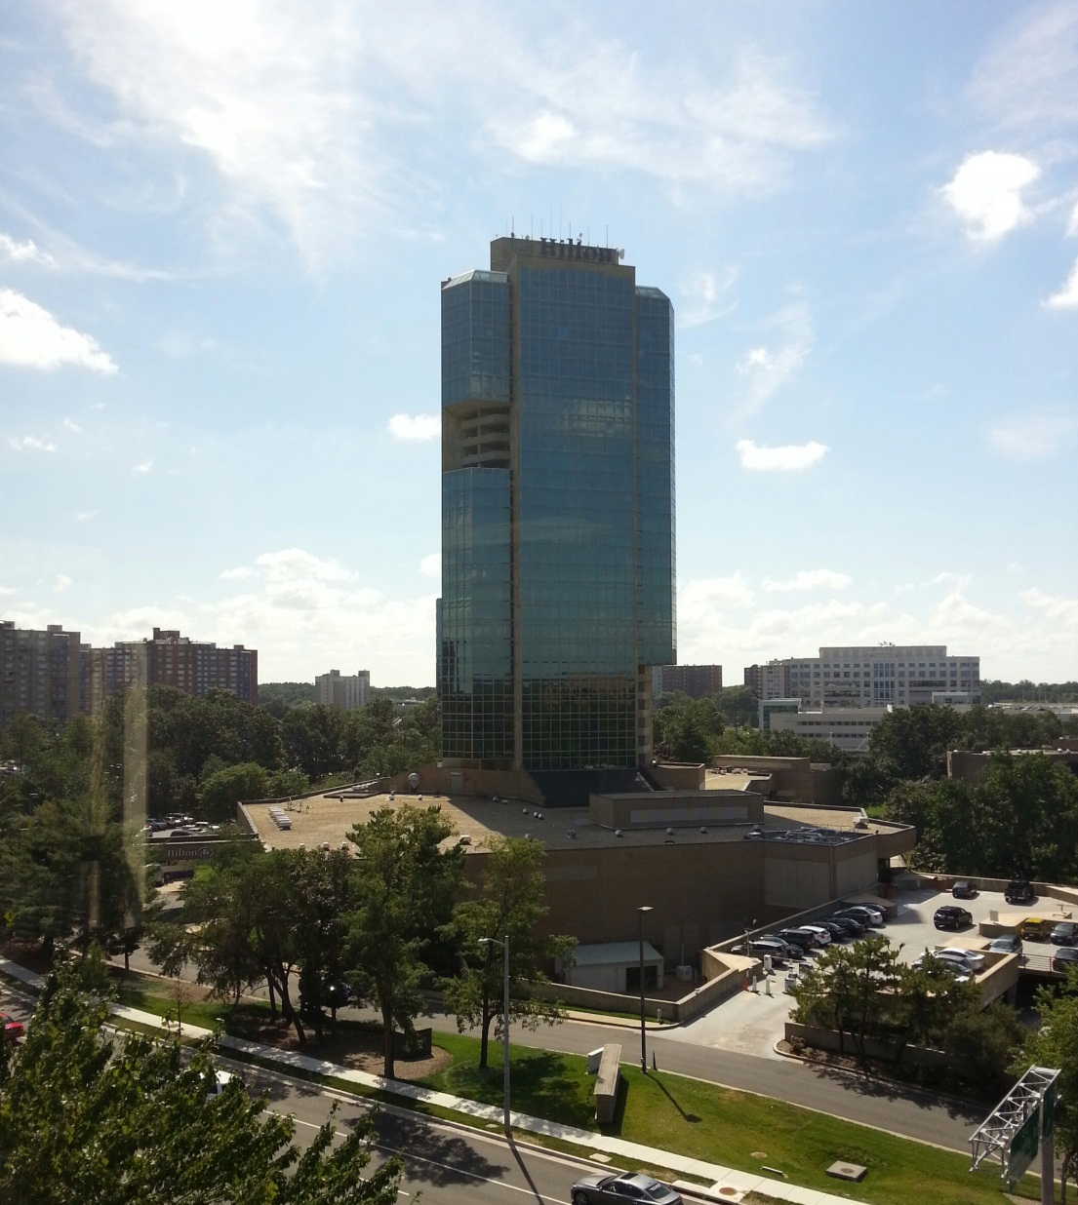
For a B4Stage4 Update
Join us at our 2015 Annual Meeting!*
Mental Health America
Hilton Mark Center
Alexandria, VA
June 3-5, 2015
*Special low price for 2014 meeting participants

Slide 14
SAFE TRAVELS. SEE YOU NEXT JUNE!

